Slide 1



Data protection for the education sector
4pm Tuesday 28 February
Notes:
1

Slide 2
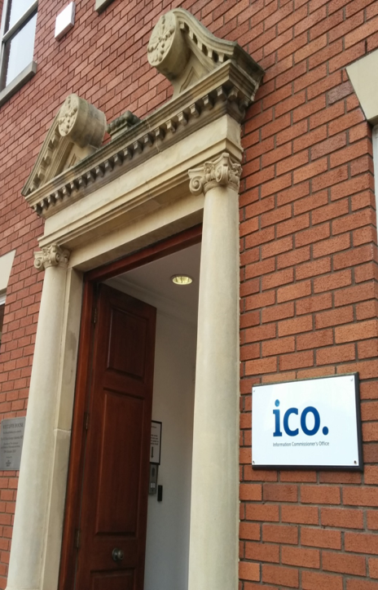
The Information Commissioner’s Office
The UK’s independent body set up to uphold information rights
Enforce and regulate freedom of information and data protection laws
Provide information and advice
Promote good practice
Notes:
The role of the ICO
Enforce and regulate
Freedom of Information Act
Data Protection Act
Environmental Information Regulations
Privacy and Electronic Communications Regulations
Provide information to individuals and organisations – guidance and helpline
Adjudicate on complaints / act on concerns where appropriate to do so
Promote good practice – audits, advisory visits, self-assessment projects

Slide 3



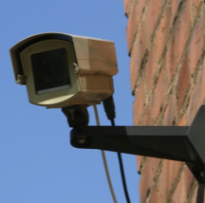

…data which relate to a living individual who can be identified –
(a) from those data, or
(b) from those data and other information which is in the possession of, or is likely to come into the possession of, the data controller
Personal data
Notes:
Data protection law applies when schools, as data controllers are processing personal data.
What is personal data?
See slide. It includes student and staff records, as well as information held and used about parents and alumni. CCTV images, website photos and information, educational apps, etc. Paper-based and digital.
“Processing” refers to anything a school does with personal data – collecting, using, analysing, sharing, and disposal.

Slide 4
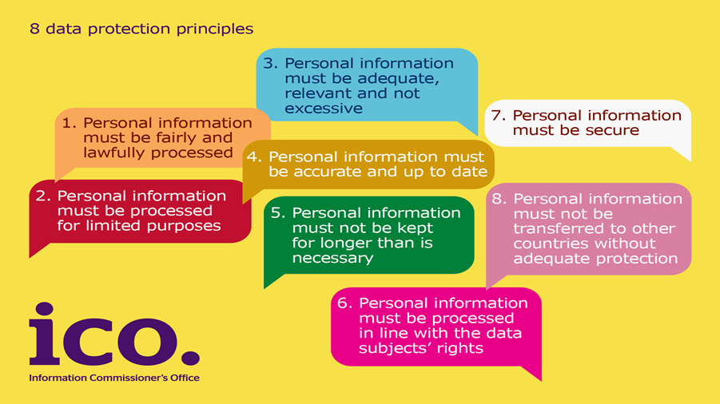
The Data Protection Act 1998
Notes:
Current DP law – the DPA 98. It applies when data controllers (schools in this case) are processing PD.
Schools – you are effectively the data controller (technically it’s the governing body, or proprietor of an academy), therefore the school is responsible for data protection compliance. (Even when you use data processors like Capita SIMS, shredding companies or cloud IT providers – they are your data processors and you are still responsible.)
Brief summary of principles
1 – Fair and lawful
Comply with other laws
Cause no unwarranted detrimental effects on people
Only do with people’s data what they would reasonably expect you to
Be transparent – inform people what you are doing with their data
2 – Limited and specified purposes
Be clear for what purpose you collect, hold and use people’s data – and don’t use for other unrelated purposes
3, 4, 5 – data quality principles
Adequate, relevant, not excessive – enough for what you need the data for, but no more
Accurate and up to date
Kept no longer that is necessary – have a appropriate retention policy in place, and stick to it
6 – processed in line with data subjects’ rights
E.g. subject access rights –
7 – Secure
Actually the requirement is to have appropriate measures in place to secure the data
Includes having appropriate agreements with data processors
8 – Transfers outside the EEA
OK as long as adequate protection is in place
So what happens if a DC fails to comply with the principles?

Slide 5
ICO data protection enforcement
£500,000
Notes:
So what happens if a DC fails to comply with the principles?
Currently, the ICO has a range of enforcement tools available to use when a data controller fails to comply with the DPA:
- offer advice, no further action taken
Enforcement tools available:
- agree an undertaking
- issue an enforcement notice
- issue a civil monetary penalty of up to £500,000

Slide 6

Fair and lawful
Make sure you have a legal basis to process personal data
Only collect what you need
Clearly tell individuals what personal data you are collecting and why
Notes:
Over the next few minutes, we’re going to highlight some of the principles in a bit more detail to see how they apply to what schools do, and what you need to do about it.
Principle 1 requires that:
Personal data shall be processed fairly, lawfully and in accordance with an appropriate schedule condition (2 or 2&3)
Make sure you have a legal basis for the processing:
Lawful – don’t break any other law e.g. common law duty of confidentiality; HRA
Need a good legal justifiable reason/basis for the processing. In the DPA these are found in schedules 2 and 3 - for processing personal data you must identify a relevant schedule 2 condition that applies, and if the personal data is sensitive (health, racial or ethnic origin, religious beliefs, criminal offences, sexual life, etc) a relevant schedule 3 condition must also apply.
Example conditions that schools currently rely on are:
- necessary for a legal obligation
- necessary for a function of a public nature exercised in the public interest
- consent
Note that most of the conditions require the processing to be ‘necessary’ – this means you should only collect and use what you need for your purpose.
Fair:
No unwarranted detrimental effects on individuals
Within the reasonable expectations of parents, pupils and staff whose PD it is.
Clearly tell them what you’re doing with their data. Privacy notices and other, more innovative ways.
Do your pupils and parents know what you do with their data? Do they know why you collect it, what you send to the DfE, or share with other organisations, and why? Do they know if you use CCTV or other surveillance technologies in school? Do they know what data you use to monitor pupil progress?
This is also an important principle when deciding if it’s OK to share / disclose information to, other organisations.

Slide 7
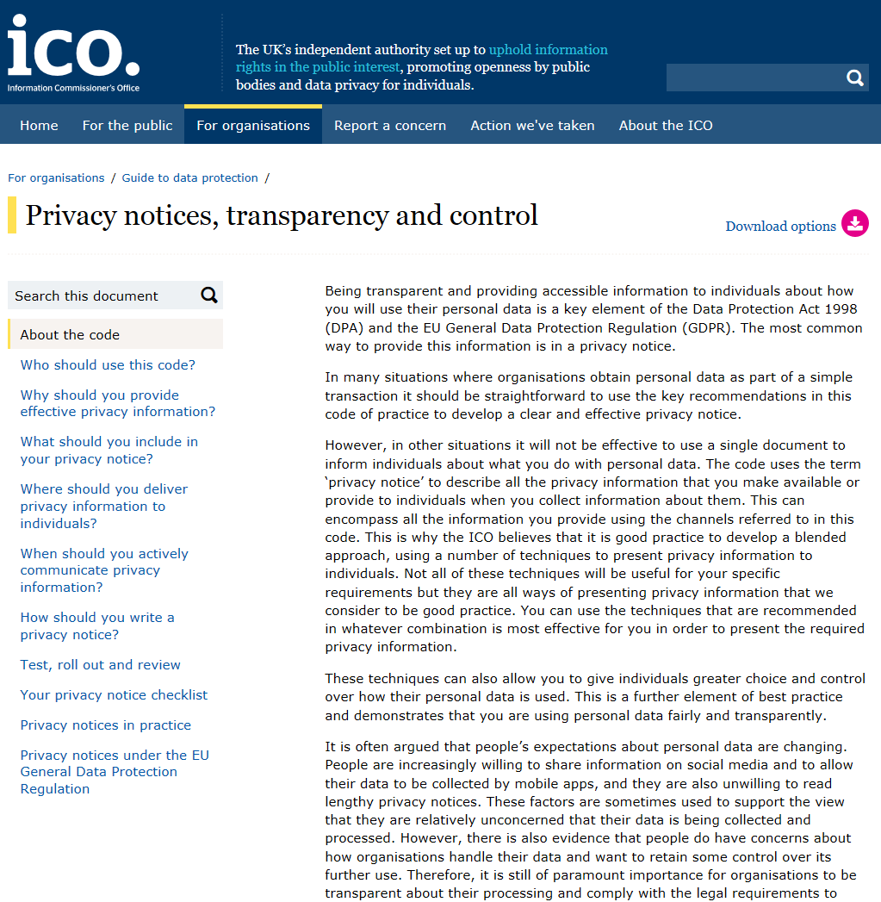
Privacy notice
What information is being collected?
Who is collecting it?
How is it collected?
Why is it being collected?
How will it be used?
Who will it be shared with?
ico.org.uk/for-organisations/guide-to-data-protection/privacy-notices-transparency-and-control/
Notes:
Privacy notices are an important and necessary way of being transparent and telling parents, pupils and staff what you’re doing with their information.
You should have a clear privacy notice and make people aware of it – on your website, on your noticeboard, in communications with parents and staff. It should tell people the detail in the bullet points on the slide.
In England, the DfE provide a template privacy notice for schools and local authorities, which describes what your school is likely to be doing with pupil data in terms of the pupil census and returns to the DfE, but whilst this is helpful you should always check and add to it so that parents and pupils get a complete picture of what you do with their data. In other regions of the UK some councils have assisted with templates in the past, but the same will apply – make sure you tailor any templates you use so that they clearly and accurately reflect what you do with people’s data.
You’ll also have to consider how you provide privacy notices to staff, about what you do with their data.
Our recently-updated guidance - Privacy notices, transparency and control code of practice - is a must-read to help you comply in this area.

Slide 8
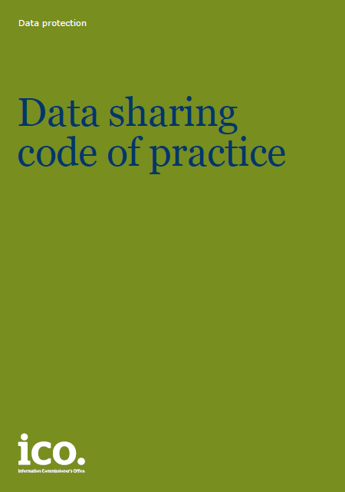
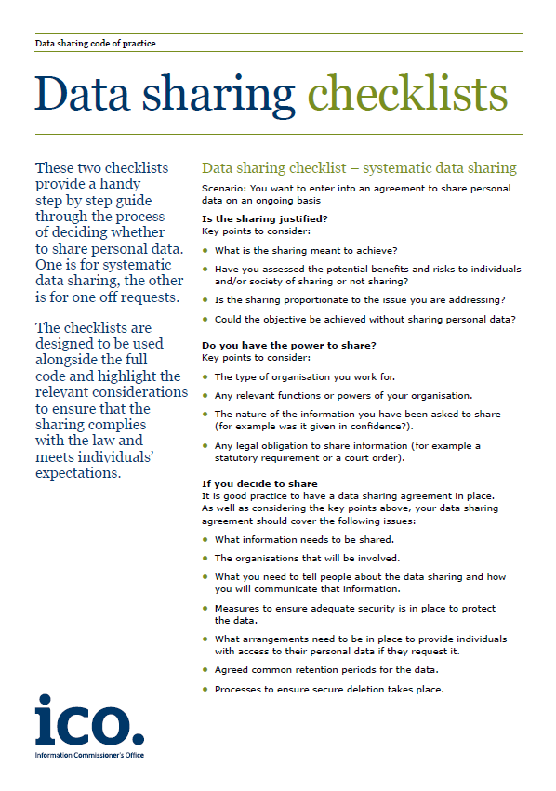
Notes:
First principle requirements of having a legal basis, being fair and transparent, and only processing people’s data in a way within their reasonable expectations are especially important when sharing people’s personal data – when asking questions such as “can I share?” “who with?” “for what purposes?” and “how?”.
There are many situations in which schools might share data about their pupils or staff, for example:
With local authorities – for admissions, or for local initiatives around preventing NEETs for example, or Troubled Families programmes
With the DfE as part of the pupil census
With examining boards
With the police
With school nurses
The ICO has a statutory code on data sharing, which provides helpful advice and guidance. It includes a checklist to make sure you ask the really important questions when approached by another organisation to share personal data with them. It covers things like:
Questioning whether the request is clear, justified and proportionate.
Ensuring you have provided fair processing information to the people whose data it is.
Ensuring there are appropriate security and governance arrangements, such as:
How will data be transferred? How will access be controlled?
How long will data be retained?
It also sets out that where sharing is fairly frequent, a data sharing agreement is a good idea to document all this.

Slide 9
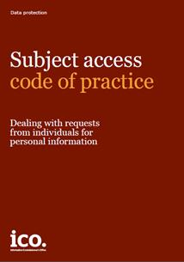

Individuals’ rights
Notes:
The DPA gives rights to individuals whose personal data is being processed. Pupils, parents and staff have a number of rights including:
- subject access – the right to be told what information is being processed about them, who by, who it is shared with, and for what purposes. It also gives them the right to have a copy of the personal data you process about them, for a small fee, within 40 days of their request. Dealing with subject access requests can be complicated at times, and our Subject access code of practice has lots of good practice advice on dealing with requests, including particular issues around when children are competent to make their own requests, without the involvement of their parents.
Other rights exist too, e.g.
- the right of an individual to request the data controller to stop processing personal data about them (only applies in certain circumstances)
- the right to have inaccurate data rectified

Slide 10

Security of personal data
Seventh principle:
Appropriate technical and organisational measures shall be taken against unauthorised or unlawful processing of personal data and against accidental loss or destruction of, or damage to, personal data.
Notes:
Security is a vitally important part of data protection compliance. The seventh principle of the DPA states that…
To comply, you need to ensure that your school has taken appropriate measures to protect the personal data it processes.
Think about all the personal data you hold:
Manual records – what files do you have? How can you keep these appropriately secure?
- where do you store them? (locked cabinets, locked rooms etc)
- who has access to them? (teachers, administration staff, governors?)
- Have you got any stored away in an archive?
- Do you securely destroy records in line with a retention policy?
- How do you transport them if needed?
- What about if you need to share information? How is it sent? Do you know if it’s been received by the correct recipient?
- Do staff need to take records out of the office, for working at home or at other premises? Do you allow this?
What about electronic files and portable devices? –
- lots of what we have already said already applies
- are the files / devices encrypted?
- do you have a secure password policy that staff stick to?
- do you have role-based access controls with individual logons?
- what about uploading or sending data to other organisations when you need to, what mechanisms do you use? Are they secure?
- do staff have the ability to access school systems and data outside of school? How?
- Do you allow BYOD?
Examples of security incidents we’ve seen in schools:
Human error, often combined with inadequate policies in place:
Full sickness record mistakenly sent to new employer as part of a reference
Letters and emails sent to the wrong parents, including SEND, disciplinary, health and other sometimes sensitive pupil information
- SPD lost in the post - recorded delivery, but not "track and trace" and not marked "private and confidential" - hearing to investigate complaints about exclusion from school
- pupil PD found at printer by another pupil
pupil reports sent to the wrong address
- email addressing - non-use of BCC where it would have been appropriate
- text message re pupil's behaviour meant for parents sent to all parents in error
- data file with staff and pupil PD accidentally placed in shared drive
- pupil data sheets given to incorrect recipients
- disclosure of pupil's information to absent father
spreadsheet uploaded to website - full details of pupil premium spending
Technical measures - passwords
parent passwords to access child information not sufficiently strong
Technical security measures
website security - personal data accessible. Insufficient pen testing, inaccurate coding
sending SPD via unprotected email
- lost unprotected USB sticks including pupil data (academic progress etc)
- unencrypted drives / laptops / devices stolen from staff homes / cars / bags
school website hacked, administrator passwords stolen. One teacher used the same password for her website administrator access and her access to the main school pupil database. Hackers accessed information from the database.
The seventh principle also sets out the requirements for when you use data processors (as we mentioned before, for example using Capita SIMS or other system providers for processing your pupil data, using shredding companies to shred confidential paper waste, using cloud IT providers)
When you use a data processor, the seventh principle requires:
- that you choose a processor who offers sufficient guarantees that they can look after your data properly
- that you have a contract in place setting out that the processor keeps the data as secure as you would have to under the law, and that they are to only process data in they way you instruct them to
- that you take reasonable steps to ensure that the processor complies

Slide 11
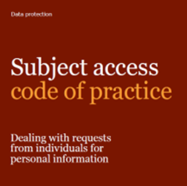

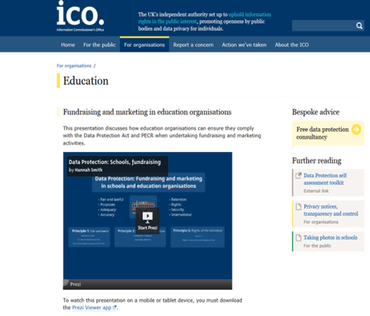


Guidance for the education sector
ico.org.uk/for-organisations/education/
Notes:
There’s a wealth of guidance on the ICO website:
General data protection guidance – subject access, IT security, BYOD, CCTV, privacy notices, data sharing
School-specific guidance – taking photos in schools, publication of exam results
Videos – data protection for school leaders
Presentations – fundraising and data protection in schools

Slide 12

The future of data protection: GDPR
Notes:
So far so good. If all of what we’ve said so far, your school has in hand, great.
On 25 May 2018 a new data protection law will come into force across all of Europe – the GDPR (General Data Protection Regulation)
Many of the GDPR’s main concepts and principles are much the same as those in the current Data Protection Act (DPA), so if you are complying properly with the current law then most of your approach to compliance will remain valid under the GDPR and can be the starting point to build from. However, there are new elements and significant enhancements.
It is important to use the Information Commissioner’s Office (ICO) resources we are providing on our website to work out the main differences between the current law and the GDPR. Over the next few months the ICO will produce more guidance and other tools to assist preparation. The Article 29 Working Party will also be producing guidance at European level.

Slide 13
The General Data Protection Regulation
Same basic principles as current DP law, but strengthened
Accountability
New rights for individuals, and strengthening of existing rights
Breach reporting
Data Protection Impact Assessments
Higher penalties for non-compliance
ico.org.uk/for-organisations/data-protection-reform/
Notes:
Some of the main features of the GDPR are as follows.

Slide 14
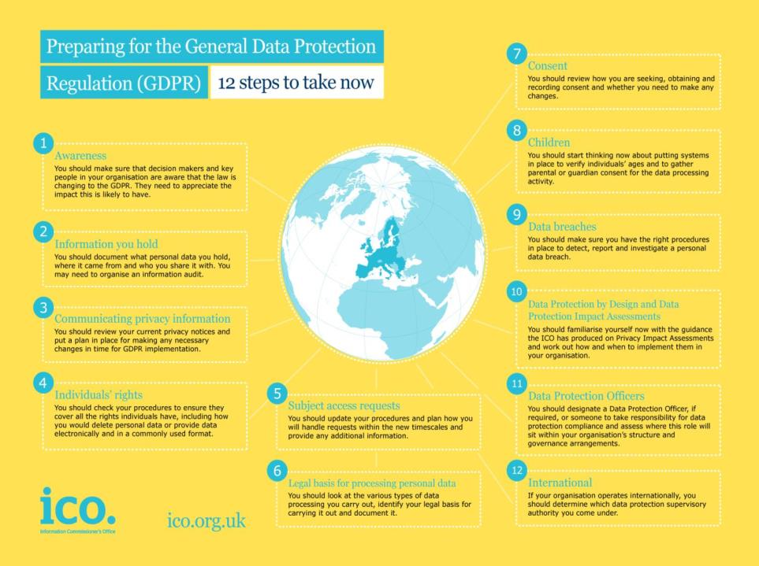
Minimise the risk
Assess the risk – what personal data do you process, and how?
Policies
Responsibilities
Training and awareness
Notes:
As a starting point, the ICO has developed 12 steps to take now – for organisations to make a start in planning how they’re going to comply by May 2018.
You’ll need to check them all, but a few highlights include:
Privacy notices - Under the GDPR there are some additional things you will have to tell people. For example, you will need to explain your legal basis for processing the data, your data retention periods and that individuals have a right to complain to the ICO if they think there is a problem with the way you are handling their data. Note that the GDPR requires the information to be provided in concise, easy to understand and clear language.
The ICO’s Privacy notices code of practice was revised a couple of months ago and now reflects the new requirements of the GDPR. Make sure you read it and make the changes you need to.
Individual rights - The main rights for individuals under the GDPR will be:
• subject access
• to have inaccuracies corrected,
• to have information erased,
• to prevent direct marketing,
• to prevent automated decision-making and profiling, and
• data portability.
You’re likely to come across some, if not all, of these in schools so you’ll need to know what your obligations are so you can properly deal with any requests you receive.
SARs - The rules for dealing with subject access requests will change under the GDPR. In most cases you will not be able to charge for complying with a request and normally you will have just a month to comply, rather than the current 40 days. There will be different grounds for refusing to comply with subject access request – manifestly unfounded or excessive requests can be charged for or refused. If you want to refuse a request, you will need to have policies and procedures in place to demonstrate why the request meets these criteria.
Consent – if you process any personal data on the basis of consent, you’ll have to review how you are seeking, obtaining and recording consent and whether you need to make any changes. Consent must be freely given, specific, informed and unambiguous, and a positive affirmation of the individual’s agreement. That’s a high standard. This will likely be relevant for any contact preferences you may have set up with parents and alumni, perhaps for school fundraising purposes.
Children - You should start thinking now about whether you will need to gather parental or guardian consent for the data processing you carry out. For the first time, the GDPR will bring in special protection for children’s personal data, particularly (ONLY) in the context of commercial internet services such as social networking. If you arrange for children in your school to sign up for apps in the classroom, or for homework, you’ll need to think about how consent can be obtained.
Data breaches - You should make sure you have the right procedures in place to detect, report and investigate a personal data breach – for example if you lose some personal data or disclose data to the wrong recipient. The GDPR will bring in a breach notification duty for all organisations. Not all breaches will have to be notified to the ICO – only ones where the individual is likely to suffer some form of damage, such as through identity theft or a confidentiality breach. If you do need to report it you’ll have to do it within 72 hours of the breach being discovered.
You should start now to make sure you have the right procedures in place to detect, report and investigate a personal data breach.
Data Protection by Design and Data Protection Impact Assessments – When your school is considering using data in new and innovative ways, or considering implementing new technology to monitor pupils in some way, it’s currently good practice to carry out a privacy impact assessment. This will become a legal requirement in some circumstances under the GDPR. You should familiarise yourself now with the guidance the ICO has produced on Privacy Impact Assessments (PIAs) and work out how to implement them in your organisation. You should start to assess the situations where it will be necessary to conduct a DPIA.
It has always been good practice to adopt a privacy by design approach and the ICO has recommended organisations use privacy impact assessments for some time now. However the GDPR will make this a legal requirement for some projects.
Data Protection Officers – Many schools will need to designate a Data Protection Officer. You’ll need to decide who this will be - or at least identify someone to take responsibility for data protection compliance and assess where this role will sit within your organisation’s structure and governance arrangements. The GDPR will require some organisations to designate a Data Protection Officer – all public authorities must so many schools will require one.

Slide 15
Demonstrating compliance
“The controller shall be responsible for, and be able to demonstrate compliance with the Principles”
Article 5(2)
Requirement to implement appropriate technical and organisational measures
Maintaining records on processing activities
Data protection impact assessments
Requirement to appoint a data protection officer
Data protection by design and default
Codes of conduct and certification schemes
Notes:
This is a really key development. Organisations will have to be able to demonstrate how they comply with the new law.
It’s important then that your school is committed at the highest level to putting the policies and procedures in place to comply.
Examples of how this can be done:
- implement appropriate technical and organisational measures
- maintain records on processing activities
– e.g. records of what data you’ve shared with which organisations, and how you made the decision to do so
- DPIAs- perhaps you considered implementing a new web monitoring system in the classroom, or BWV for pupil incidents, or considered sharing data with a local troubled families or NEET-prevention initiative – it might be appropriate to carry out a DPIA

Slide 16

What can I do to prepare?
https://ico.org.uk/for-organisations/data-protection-reform/
ICO guidance
  12 steps
  Overview of the GDPR
  Privacy notices code of practice
EU guidance
  Right to data portability
  DPOs
  Identifying a lead supervisory authority
Notes:
There’s several pieces of guidance available now, both from the ICO and at EU-level.
There are plans to provide more guidance as GDPR draws nearer, for example:
- risky processing
- consent
- big data 2.0
- profiling
- contracts/liability
- fines
- children’s privacy

Slide 17
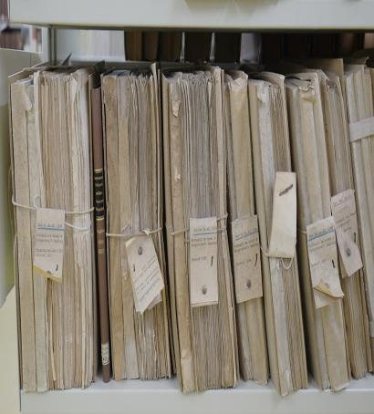

Where to start?
Information asset audit
  What data do we process?
  For what purposes?
  What legal basis do we use?
  Who do we share data with?
Notes:
So we’ll read the guidance – but how else do we prepare ourselves?
A good start is to carry out an information asset audit – know what data you have, for what purposes you’re processing it, who you’re sharing it with, what legal basis / schedule conditions are you processing it under.
ICO good practice guidance – such as Conducting privacy impact assessments COP, Privacy notices COP, Data sharing COP, Anonymisation, cloud computing etc – if you don’t already, look at it and see how you could process data in accordance with it, as much of our good practice guidance is included in the GDPR as law.

Slide 18




Keep in touch
ICO helpline: 0303 123 1113
Subscribe to our e-newsletter at www.ico.org.uk
or find us on…
@iconews

